Slide 1



Sethuraman B_Undersating_Career_Aspiration of Genz
View in Power BI
Last data refresh:
21/05/2023 15:02:11 UTC
Downloaded at:
21/05/2023 15:04:47 UTC

Slide 2
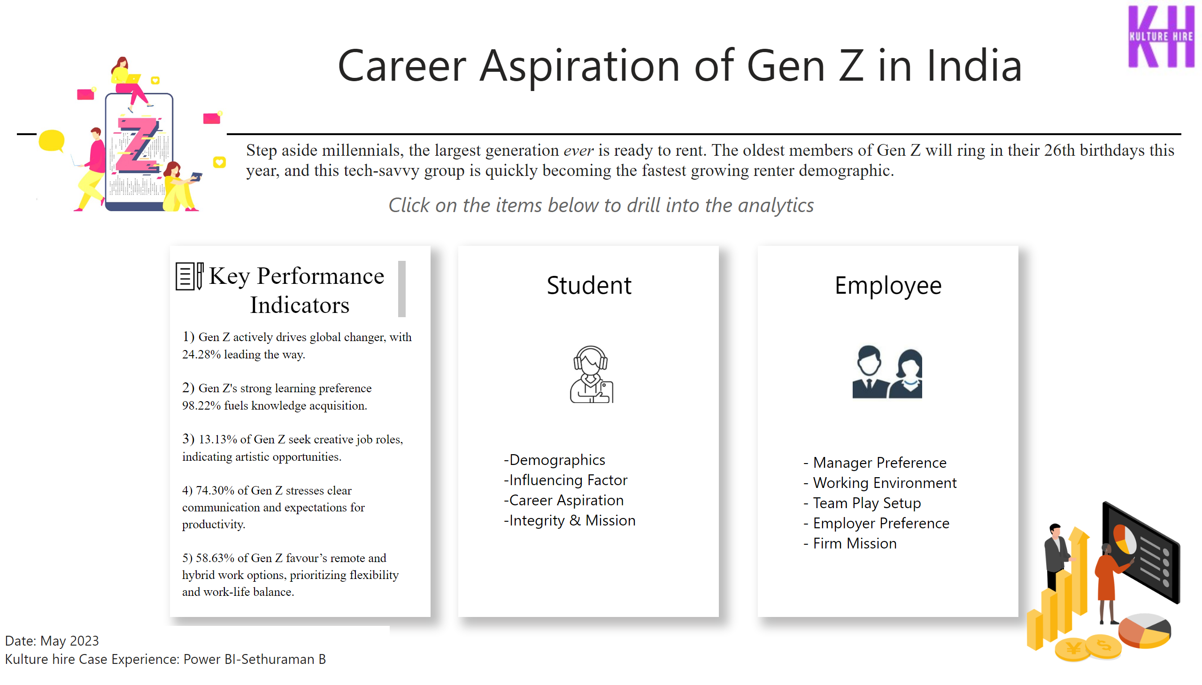
Welcome
Notes:
shape
No alt text provided
textbox
No alt text provided
textbox
No alt text provided
textbox
No alt text provided
textbox
No alt text provided
textbox
No alt text provided
textbox
No alt text provided
textbox
No alt text provided
textbox
No alt text provided
image
No alt text provided
image
No alt text provided
basicShape
No alt text provided
basicShape
No alt text provided
basicShape
No alt text provided
textbox
No alt text provided
textbox
No alt text provided
image
No alt text provided
image
No alt text provided
image
No alt text provided

Slide 3
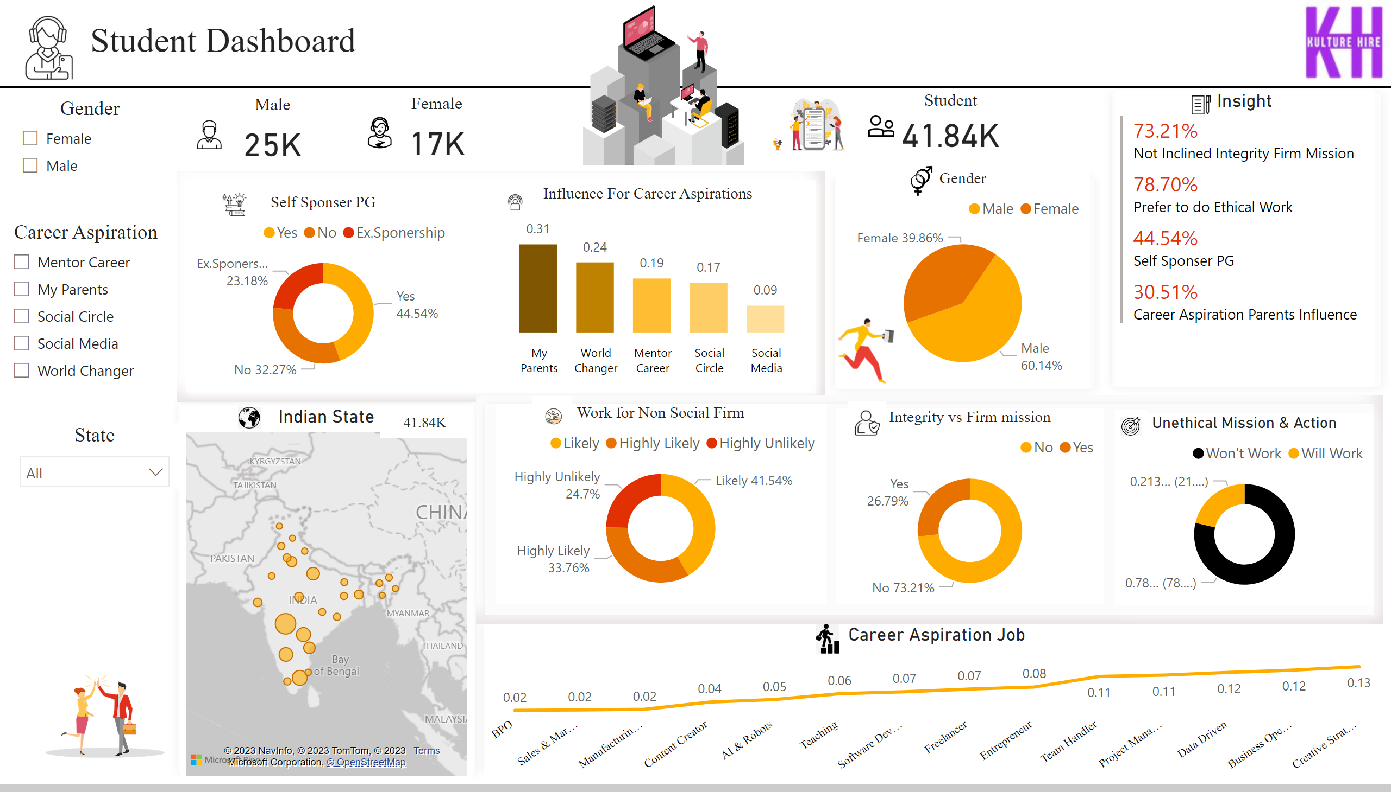
Student Dashboard
Notes:
shape
No alt text provided
textbox
No alt text provided
Gender
No alt text provided
Gender
No alt text provided
Career Aspiration
No alt text provided
image
No alt text provided
image
No alt text provided
image
No alt text provided
Student
No alt text provided
image
No alt text provided
Female
No alt text provided
image
No alt text provided
Male
No alt text provided
State
No alt text provided
Count
No alt text provided
Indian State
No alt text provided
Insight
No alt text provided
image
No alt text provided
image
No alt text provided
Influence For Career Aspirations
No alt text provided
image
No alt text provided
Self Sponser PG
No alt text provided
shape
No alt text provided
image
No alt text provided
image
No alt text provided
Unethical Mission & Action
No alt text provided
image
No alt text provided
Integrity vs Firm mission
No alt text provided
image
No alt text provided
Work for Non Social Firm
No alt text provided
shape
No alt text provided
image
No alt text provided
shape
No alt text provided
shape
No alt text provided
shape
No alt text provided
shape
No alt text provided
image
No alt text provided
Career Aspiration Job
No alt text provided
image
No alt text provided
image
No alt text provided
image
No alt text provided

Slide 4
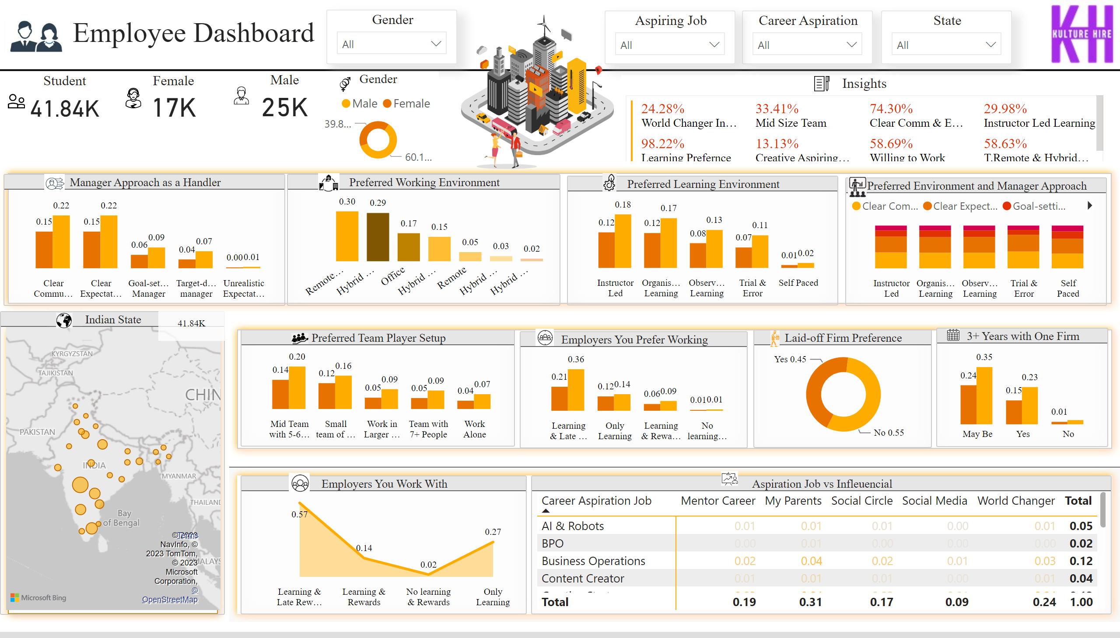
Employee Dashboard
Notes:
Aspiring Job
No alt text provided
image
No alt text provided
shape
No alt text provided
shape
No alt text provided
shape
No alt text provided
shape
No alt text provided
Preferred Team Player Setup
No alt text provided
Manager Approach as a Handler
No alt text provided
3+ Years with One Firm
No alt text provided
Aspiration Job vs Infleuencial
No alt text provided
Employers You Work With
No alt text provided
Preferred Environment and Manager Approach
No alt text provided
image
No alt text provided
image
No alt text provided
image
No alt text provided
Employers You Prefer Working
No alt text provided
image
No alt text provided
image
No alt text provided
Preferred Learning Environment
No alt text provided
image
No alt text provided
image
No alt text provided
Laid-off Firm Preference
No alt text provided
image
No alt text provided
image
No alt text provided
image
No alt text provided
Insights
No alt text provided
Preferred Working Environment
No alt text provided
image
No alt text provided
image
No alt text provided
shape
No alt text provided
textbox
No alt text provided
image
No alt text provided
image
No alt text provided
State
No alt text provided
image
No alt text provided
image
No alt text provided
image
No alt text provided
Gender
No alt text provided
Career Aspiration
No alt text provided
Female
No alt text provided
Indian State
No alt text provided
Male
No alt text provided
Count
No alt text provided
Student
No alt text provided
Gender
No alt text provided
image
No alt text provided

